Slide 1
The Lens of Medical Discoveries of the Civil War
F. Faust & J. Peters

Slide 2
Science &
Medicine

Slide 3
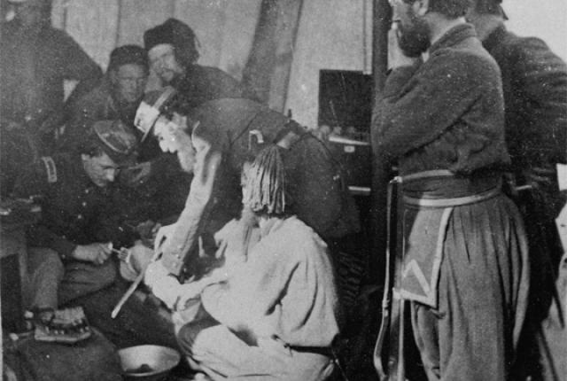
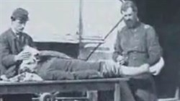
Amputationhttp://civilwarhome.com/index.html

Slide 4
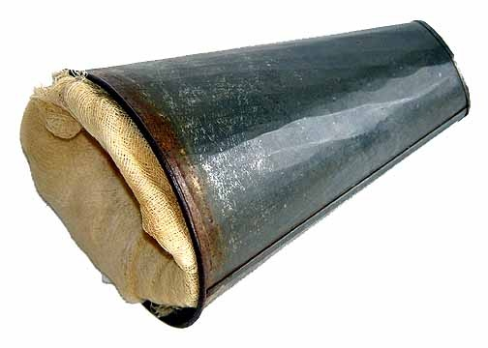
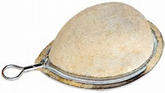
Anesthesia

Slide 5
Science & Technology
http://www.history.com/topics/american-civil-war/civil-war-technology
http://www.americancivilwarstory.com/civil-war-inventions.html

Slide 6
Technology

Slide 7
Education & the Civil War
http://www.civilwar.org/education/history/on-the-homefront/culture/education.html

Slide 8
Education

